Slide 1

Predicting Loan Default with Lending Club
Thomas Friss
Thinkful data science bootcamp

Slide 2
What is Lending Club?
Lending Club is a financial institution that allows for investors to lend money to borrowers seeking loans for medical, business or personal reasons.
Investors browse loan requests by prospective borrowers and choose whether or not to contribute to the loan request.
Individual investors can invest as little as $25 per loan allowing investors with small amounts of capital to still create a portfolio of invested loans.
Investors are able to examine information about the borrower and the loan itself to help in deciding whether or not to contribute to the loan.

Slide 3

My Project
The goal of the project was to examine the data provided from Lending Club and see if a useful predictive model could be constructed from the information provided.
Lending Club’s data is publicly available on both Kaggle and the web page for Lending Club
Several different models were used to predict loan performance with the most successful being a random forest model.
Photo Source: https://medium.com/@williamkoehrsen/random-forest-simple-explanation-377895a60d2d

Slide 4
Model Results
Model | Accuracy | Precision (True Positive) | Specificity(True Negative)
Random Forest 1 | 98% | 99% | 93%
Random Forest 2 | 98% | 99% | 93%
Gradient Boost | 98% | 99% | 89%
XGB Classifier | 98% | 98% | 87%
Gaussian Naïve Bayes | 95% | 95% | 60%

Slide 5
Exploring the Data
The dataset has approximately 2.26 million rows and 145 columns with 3 columns that only contain null values and an additional 36 non-numeric columns.
The data required extensive and aggressive cleaning due to high percentages of null values
After cleaning was conducted we were left with 2,013,799 rows and 66 columns

Slide 6
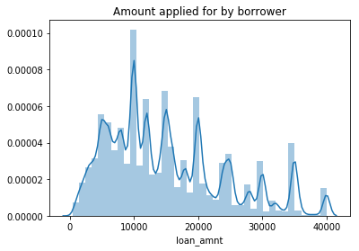
Loan Amount Distribution
We can see the distribution of loan amounts borrowers have applied for.
There are upward spikes near increments of $10,000 with a general downward trend after $5,000

Slide 7
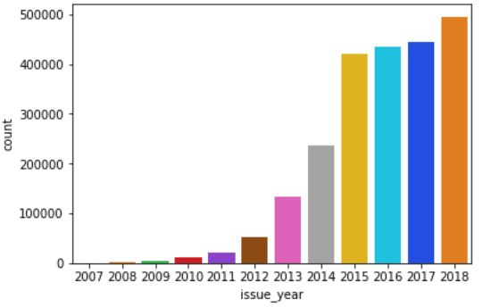
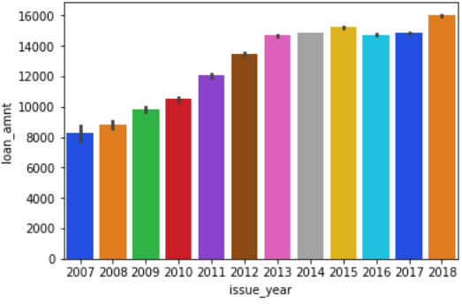
Company growth over time
The volume and average dollar value for each loan has increased since 2007 with the number of loans issues per year rising sharply between 2012 and 2015.

Slide 8
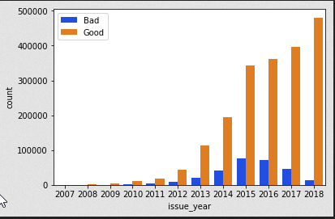
Good and bad loans by year
On this graphic loans marked as “1”

Slide 9
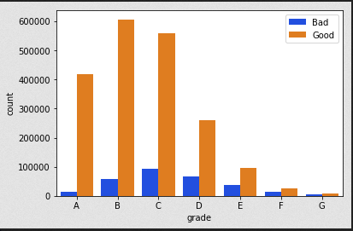
Loan Grades
The notes are graded from A to E based on risk with A being the highest and E being the lowest.
Riskier notes have higher interest rates but higher chance of default.

Slide 10
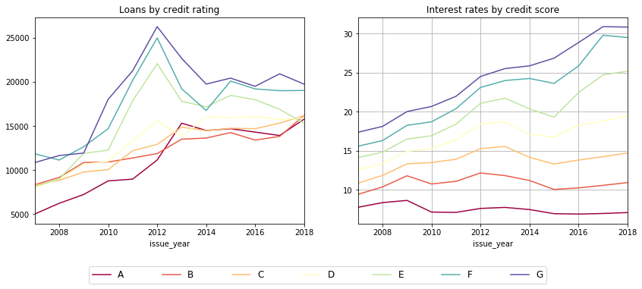
Loans by Credit Score
An examination of the loans by credit rating. Loans are listed in the legend in order of safety with A being the safest and G being the most risky.

Slide 11

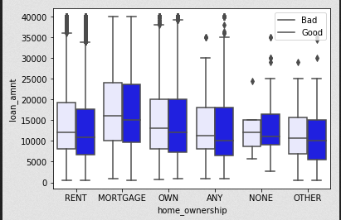



Loan Statistics by Home Ownership Status

Slide 12
Analyzing the Data
Approximately 14% of the loans issued through Lending Club go into late status or default.
Before creating the models a new column was created with a simple 1 or 0 binary depending on if the loan stayed current (1) or went into some kind of unwanted status (0)
This created a heavily imbalanced data set which would have created complications during modeling so the results were under sampled to create an even balance of good and bad loans to train the models on.

Slide 13
Random Forest Results
The Random Forest Classifier created a model with a overall 95.9% accuracy.
Number of Estimators: 100
Misclassification Rate: 4.03%
True Positive Rate: 99.14%
False Positive Rate 7.21%
True Negative Rate: 92.79%
This model has the best specificity of the models tested.

Slide 14
Random Forest Confusion Matrix
Confusion Matrix | Predicted Bad | Predicted Good
Actual Bad | 46,482 | 3,499
Actual Good | 3,097 | 349,682

Slide 15
XGB Classifier
98.44% Overall accuracy
99.99% True Positive Rate
12.57% False Positive Rate
Worse specificity than the random forest model but fantastic ability to identify good loans.

Slide 16
XBG Confusion Matrix
 | Predicted Bad | Predicted Good
Actual Bad | 43,939 | 6,561
Actual Good | 5 | 352,255

Slide 17
Gradient Boosting Model
Multiple learning rates were tested: (.05, .1, .25, .5, .75, 1)
The best results used a learning rate of .75 and 1
Accuracy: 95%
Misclassification Rate: 4.48%
True positive rate: 98.99%
False positive rate: 7.96%
True negative rate: 92.03%

Slide 18
Gradient Boosted Confusion Matrix
 | Predicted Bad | Predicted Good
Actual Bad | 44,845 | 5,655
Actual Good | 206 | 352,054

Slide 19
Gaussian Naive Bayes
Worst results of the group on both accuracy and specificity.
Confusion Matrix.
Specificity of 60%
 | Predicted Bad | Predicted Good
Actual Bad | 29,930 | 20,051
Actual Good | 1,068 | 351,711

Slide 20
Further Questions
A deeper dive would be able to compare the annual returns of using different models
What are the characteristics of the loans by region and by state? Which states have the most Lending Club loans per capita and which states have the highest average default rate.
Lenders who have a loan go into default typically receive at least a portion of their original investment back. A further consideration would be to create models that include how much of the loan was paid back before the loan went into default.
An examination of the loans by each individual status could prove useful. According to Lending Club many of their loans that go into late status can be turned back into performing notes. What effect would this have on a hypothetical portfolio?

